Slide 1
Modern Machine Learning — Evaluating a Learning Algorithm Train/Validation/Test Sets
Kenneth E. Barner
Department of Electrical and Computer Engineering
University of Delaware

Slide 2
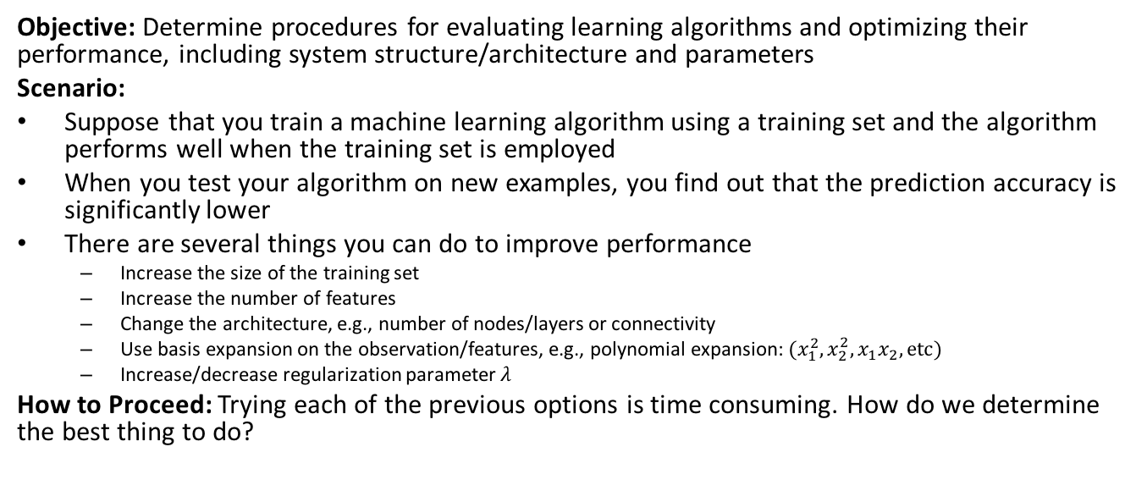
Evaluating a Learning Algorithm Train/Validation/Test Sets
Objective: Determine procedures for evaluating learning algorithms and optimizing their performance, including system structure/architecture and parameters
Scenario:
Suppose that you train a machine learning algorithm using a training set and the algorithm performs well when the training set is employed
When you test your algorithm on new examples, you find out that the prediction accuracy is significantly lower
There are several things you can do to improve performance
Increase the size of the training set
Increase the number of features
Change the architecture, e.g., number of nodes/layers or connectivity
Use basis expansion on the observation/features, e.g., polynomial expansion: $(x_{1}^{2}, x_{2}^{2}, x_{1}x_{2}, etc)$
Increase/decrease regularization parameter $λ$
How to Proceed: Trying each of the previous options is time consuming. How do we determine the best thing to do?

Slide 3
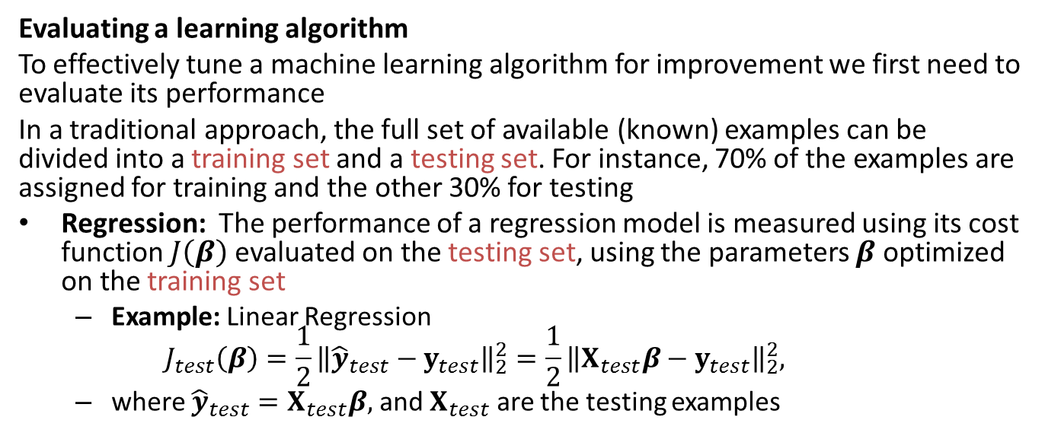
Evaluating a Learning Algorithm Train/Validation/Test Sets
Evaluating a learning algorithm
To effectively tune a machine learning algorithm for improvement we first need to evaluate its performance
In a traditional approach, the full set of available (known) examples can be divided into a training set and a testing set. For instance, 70% of the examples are assigned for training and the other 30% for testing
Regression: The performance of a regression model is measured using its cost function $J\left(β\right)$ evaluated on the testing set, using the parameters $β$ optimized on the training set
Example: Linear Regression $J_{test}\left(β\right)=\frac{1}{2}{\left\|{\hat{y}}_{test}−y_{test}\right\|}_{2}^{2}=\frac{1}{2}{\left\|X_{test}β−y_{test}\right\|}_{2}^{2},$
where ${\hat{y}}_{test}=X_{test}β,$ and $X_{test}$ are the testing examples

Slide 4
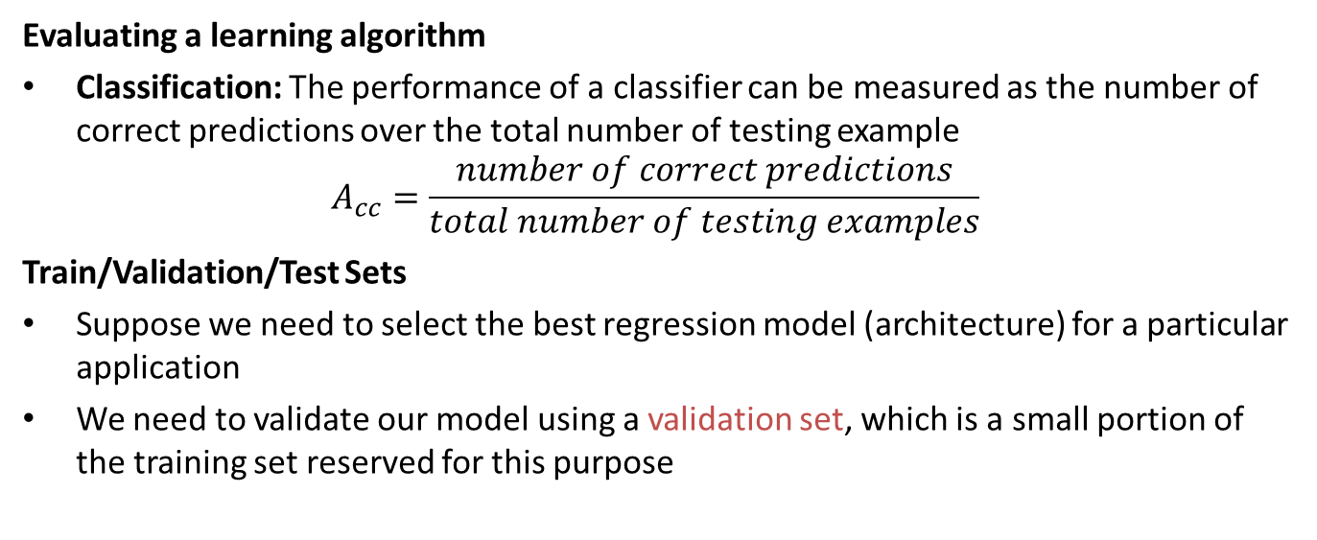
Evaluating a Learning Algorithm Train/Validation/Test Sets
Evaluating a learning algorithm
Classification: The performance of a classifier can be measured as the number of correct predictions over the total number of testing example
$$A_{cc}=\frac{number of correct predictions}{total number of testing examples}$$
Train/Validation/Test Sets
Suppose we need to select the best regression model (architecture) for a particular application
We need to validate our model using a validation set, which is a small portion of the training set reserved for this purpose

Slide 5






Evaluating a Learning Algorithm Train/Validation/Test Sets
Example: Different regression models for the same data
Observation: We must avoid overfitting and underfitting to achieve good, more generally applicable, performance
$$f(x)$$
$$f(x)$$
$$f(x)$$
Overfit
Desired
Underfit
$$x$$
$$x$$
$$x$$

Slide 6



Evaluating a Learning Algorithm Train/Validation/Test Sets
Model selection and Overfitting/Underfitting
Suppose we have a linear regression model (chosen for illustration purposes)
Training error: $J_{train}\left(β\right)=\frac{1}{2}{\left\|y_{train}−{\hat{y}}_{train}\right\|}_{2}^{2}=\frac{1}{2}{\left\|y_{train}−X_{train}β\right\|}_{2}^{2}$
Validation error: $J_{val}\left(β\right)=\frac{1}{2}{\left\|y_{val}−{\hat{y}}_{val}\right\|}_{2}^{2}=\frac{1}{2}{\left\|y_{val}−X_{val}β\right\|}_{2}^{2}$
Error
$$J_{val}\left(β\right)$$
Region 1
Underfitting, $J_{train}\left(β\right)$ and $J_{val}\left(β\right)$ high
Model is simplistic
Region 2
Overfitting, $J_{train}\left(β\right)$ low and $J_{val}\left(β\right)$ high
The model follows the training set very accurately but fails to follow new examples
Region 3
Desired, $J_{train}\left(β\right)$ and $J_{val}\left(β\right)$ low
$$J_{train}\left(β\right)$$
Degree of polynomial $d$
Observations: In general, $J_{train}\left(β\right)$, is non-increasing, while $J_{val}\left(β\right)$ is often “convex” with a minimum point

Slide 7
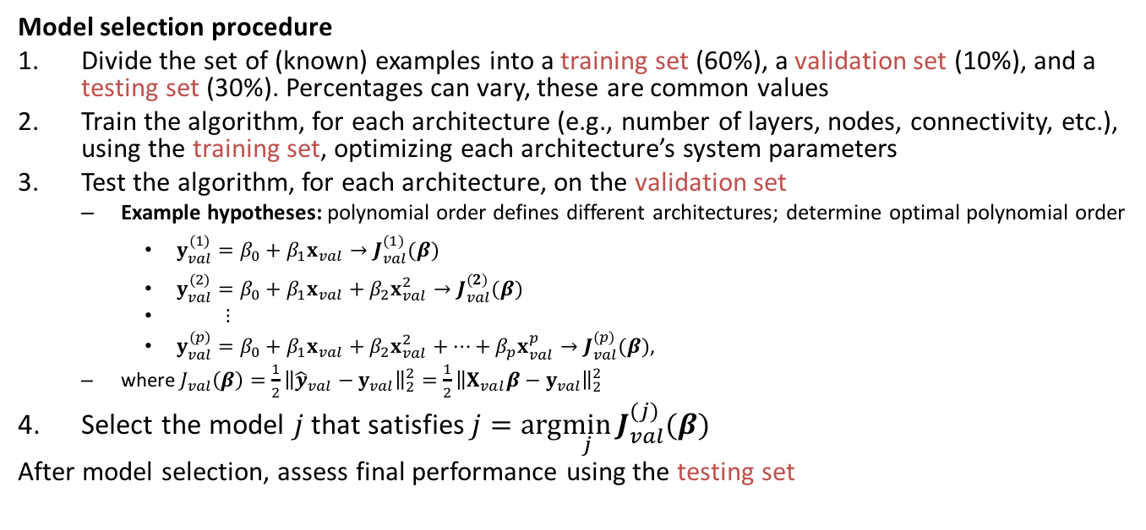
Evaluating a Learning Algorithm Train/Validation/Test Sets
Model selection procedure
Divide the set of (known) examples into a training set (60%), a validation set (10%), and a testing set (30%). Percentages can vary, these are common values
Train the algorithm, for each architecture (e.g., number of layers, nodes, connectivity, etc.), using the training set, optimizing each architecture’s system parameters
Test the algorithm, for each architecture, on the validation set
Example hypotheses: polynomial order defines different architectures; determine optimal polynomial order
$y_{val}^{(1)}=β_{0}+β_{1}x_{val}→J_{val}^{(1)}(β)$
$y_{val}^{(2)}=β_{0}+β_{1}x_{val}+β_{2}x_{val}^{2}→J_{val}^{(2)}(β)$
$⋮$
$y_{val}^{(p)}=β_{0}+β_{1}x_{val}+β_{2}x_{val}^{2}+…+β_{p}x_{val}^{p}→J_{val}^{(p)}(β)$,
where $J_{val}\left(β\right)=\frac{1}{2}{\left\|{\hat{y}}_{val}−y_{val}\right\|}_{2}^{2}=\frac{1}{2}{\left\|X_{val}β−y_{val}\right\|}_{2}^{2}$
Select the model $j$ that satisfies $j=arg\min_{j}{J_{val}^{(j)}(β) }$
After model selection, assess final performance using the testing set

Slide 8
Evaluating a Learning Algorithm Train/Validation/Test Sets
Summary:
A training set is used for fitting the parameters, e.g., weights, of a learning algorithm
A validation set is used to tune the hyper parameters, e.g., architecture, number of hidden layers or nodes, connectivity, etc., of a learning algorithm
A test set is used to assess the performance of a fully-specified classifier

